Slide 2
Housekeeping, welcome and introduction
Professor Robert Allison
Vice-Chancellor and President
Loughborough University

Slide 3
Online anonymous reporting of sexual assault and harassment. Is it effective?
Carolyn Worth
SECASA Manager
South Eastern Centre Against Sexual Assault

Slide 4
Carolyn’s presentation can be found at:
https://youtu.be/sHf-H-2OMXQ

Slide 5
Unveiling Sexual Violence
Zoe Lodrick

Slide 6
Zoe’s slides can be downloaded at:
http://www.zoelodrick.co.uk/services/training/presentations

Slide 7
Afternoon Breakout Sessions
Security in Action: From Investigation to Disciplinary
Responding to Disclosures of Sexual Violence in Higher Education
Key Messages in Campaigns: Working with the Student Body

Slide 8
Security in Action: From Investigation to Disciplinary
Geoff Feavyour
Head of Security, Loughborough University

Slide 9
Sexual Violence in Higher Education
University Policy and Procedure
Geoff Feavyour
Security Manager
Loughborough University

Slide 10
University Context
A campus University covering over 400 acres
17 Halls of residence
17,000 students including 13,000 undergraduates
4,000 new students every year
Campus culture
Large Student Union

Slide 11
Reported SV at Loughborough University in 2017
2 reports of rape, 7 reports of sexual assault, 4 reports of sexual harassment.
Out of 13 cases, 6 moved forward to Police investigation and 11 moved forward to University investigation

Slide 12
Reported SV at Loughborough University in 2017
Ongoing – 1 (police investigation)
Alleged offender not identified - 1
Alleged offender left University - 2
Victim requested no action – 1
Incident not as reported – 1
Not proved – 2
‘Pastoral discussion’ – 3
Proved, with action - 2

Slide 13
Serious Sexual Assault
October 2016
Lessons Learnt

Slide 14
Complaint
Student 1 – Dancing and touching followed by serious sexual assault in her room
Student 2 – Dancing and touching and possessive behaviour
Student 3 – Dancing and touching and angry/possessive behaviour, followed by pursuit back to her room
Student 4 – ‘Coming on’ – see Student 3

Slide 15
Background and context
Zellick (1994):
  For ‘manifestly serious offences’ internal proceedings should be suspended pending criminal outcome (changes to bail act?)
  University should not proceed if no criminal action
University Ordinance:
  ‘No action will normally be taken…unless the matter has been reported to the police’
University position:
  Assault = Assault
  Theft = Theft
  Rape/Sexual Offences = ‘Causing distress’

Slide 16
Issues during investigation
Victim/witness interference
  Stroking/’you are the one’
Evidential issues
  Student Union CCTV
  Drunkenness
Parental (& ultimately legal) involvement
  Suspect
  Victim (University attitude & impact on evidence)

Slide 17
Not Guilty
Defence represented by a Barrister
Panel:
  Training (questions)
  Understanding of ‘Balance of Probability’
  Preparedness to come to an adverse finding

Slide 18
Balance of probability
Criminal cases - proof beyond a reasonable doubt:
Juries in criminal courts in England "must be sure that the defendant is guilty”.
90%, 95%, 99%?
Civil cases, including University discipline - the balance of probability:
Often referred to in judgments as "more likely than not".
The relative seriousness of the matter does not create a ‘heightened standard’ – so the decision maker does not need to be ‘more sure’ in more serious cases:
In re H (Minors) [1996] AC 563 at 586), Lord Nicholls explained:
    The balance of probability standard means that a court is satisfied an event occurred if the court considers that, on the evidence, the occurrence of the event was more likely than not.
51%?

Slide 19
Lessons
Legal support
Changes to ordinance:
  Alignment to Sexual Assault and Sexual Violence Policy
  Removal of requirement for police involvement
  Suggested tariff
Investigative support
Training for panel
Fresher Helper training
Staff guidance leaflet and proforma

Slide 20

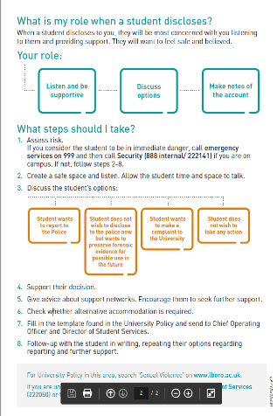
What to do if a student discloses an incident of sexual violence:

Slide 21
Sexual Violence in Higher Education
University Policy and Procedure
Geoff Feavyour
Security Manager
Loughborough University

Slide 22
Responding to Disclosures of Sexual Violence in Higher Education
Lisa Brooks-Lewis
Mental Health Support Team Manager, Loughborough University

Slide 23
Responding to Disclosures of
Sexual Violence in Higher Education
Lisa Brooks-Lewis

Slide 24

Your role

Slide 25
Listen and be supportive
Discuss options
Make notes of the account

Slide 26
Listen and be supportive
Discuss options
Make notes of the account

Slide 27
Listen and be supportive
Discuss options
Make notes of the account

Slide 28
Professional boundaries – they are to keep both you and the student safe
Organisational responsibilities

Slide 29
More training…..
Responding to disclosures of sexual violence
21st May
19th June
25th September
lldbltraining@gmail.com
Routine Enquiry – asking the question
22nd May
20th June
26th September
@kiwili279

Slide 30
Working with the student body on Sexual Violence issues
Hannah Keating, Welfare and Diversity Executive Officer, Loughborough Students’ Union
Manuel Alonso Director of Student Services, Loughborough University

Slide 31
Working with the student body on Sexual Violence issues
Hannah Keating, Welfare and Diversity Executive Officer LSU
Manuel Alonso, Director of Student Services, Loughborough University

Slide 32
Outline
The nature of the issues at Loughborough
The context for us (i.e. where we were starting from)
How we have tried to address these issues by engaging students throughout
Some observations on what has worked…and what hasn’t
Notes:
Talk about this being an output of HEFCE project.
Please just interrupt and ask questions as we go through the presentation – you don’t need to save them up for the end.
Absolutely don’t think we have this cracked but want to share our experiences from the past 2 years.

Slide 33
About Loughborough
Founded in 1909, awarded Royal Charter in 1966
Population of around 19,000 students
Strengths in Engineering and Sport
1 large campus in East Midlands and 1 campus in London (Queen Elizabeth Olympic Park)
17 halls of residence on East Midlands site with 5,500 students living on campus
Notes:
Much of our discussion will be about work at East Mids campus. Strong focus on UG population and issues up here. Different population and sets of issues at London campus.
Halls is an important factor which we will return to.

Slide 34
Our specific issues and starting point
A well-established hall culture
Male dominated student body (c. 60% male) with associated attitudes and behavior
A strong focus on sport and attending culture
Students largely from affluent backgrounds
An absence of institutional focus on SV as an issue
Notes:
It’s important to understand the specific issues for your institution as these will shape your response.
Hall culture – place that fosters community, but also that encourages ‘laddish’ behavior
And the linked to a male-dominated environment
With a strong focus on sport and some of the values that can come with that.
These factors privilege a certain set of attitudes and a certain set of behaviours.

Slide 35
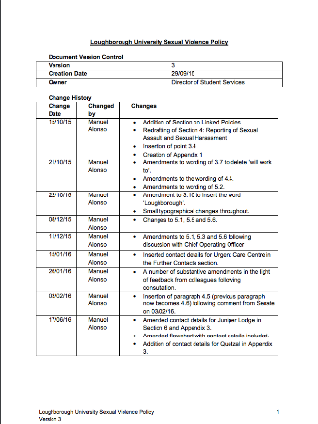
Beginning to respond (the underpinning work)
Created a joint policy (late 2015) with LSU which set out:
  Shared values and aims
  A clear process for reporting disclosures and a consistent process for responding to these
  Actions to address the culture in place
Set up a group to deliver the policy aims (includes LSU, student reps, academic colleagues and support staff)
Notes:
We started with the boring but necessary building blocks.
Convince the senior leadership team that we need clear policy in this area
Work together with LSU to create this policy so that we can try to align our institutional values
Two strands to policy:
Set out clear reporting and disclosure procedures (problems previously with no clarity on this)
Set out some clear aims also around the wider work (cultural change and development)

Slide 36
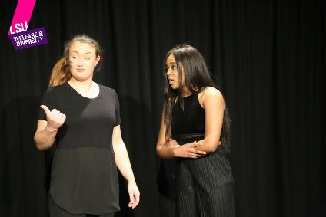
Student-led interventions – Bystander Intervention
Step-in
Bystander initiative
Written by students
Performed by students
Specific to the experience of students at Loughborough
Encouraging active-reflection on how you might challenge inappropriate behavior
Notes:
Our highlight event was our Bystander Intervention Theatre Performance, called ‘Step In: No Means No’, which was performed by 6 third year Drama students. This was an interactive piece of forum theatre, which examines the use of bystander intervention in everyday life, looking at a variety of different scernarios that our students often face, with an opportunity for the audience to intervene at any point. This event was definitely a success with around 70 students attending.

Slide 37
Student-led interventions – Speak Out Now
Speak Out Now Campaign
Imagery and campaign messages designed by Graphic Communication & Illustration students
Reviewed by the Sexual Violence Working Group
Rolled out by LSU as a campaign
Notes:
Worked with academic in charge of programme.
Defined a brief which asked them to come up a visual campaign with would support the aim of challenging SV.
The SV Working Group ended up considering around 30 different treatments before selecting one which LSU to rolled out.
Nice example of getting the student body to generate the content on an issue which we want them to engage with.

Slide 38
Student-led Interventions - Workshops
Consent Workshops
Created by the first Consent Workshop Coordinator
Adapted from NUS content
Loughborough-specific
First Responder Workshops
Delivered to all Hall Committee members (approx. 300 students)
Simple process
S.T.A.R.
Notes:
The Consent Workshop content was created by our Consent Workshop Coordinator, Carys Page, who was a student volunteer at the time. Alongside the Welfare & Diversity E.O., she attended conferences and workshops to further her knowledge. She mainly used some content from the NUS workshops, but she wanted to adapt this to make it more appealing to our specific demographic of students. She asked herself what she’d want to know about consent if she hadn’t known much, for example including information about both verbal and non-verbal signs of consent. She also touched on the relationship between consent and alcohol, as this seemed to be a common area of concern for students.
Regarding the First Responder Workshops, we wanted to ensure that there was a simple process, in line with the University and Students’ Union’s Sexual Violence Policy, for high level student volunteers to use to get a disclosure to the correct place. The Consent Workshop Coordinator at the time understood that the most important outcome was for the student disclosing to get access to support as soon as possible. Statistics of the prevalence of sexual violence incidents on campus were included to ensure the volunteers understood the importance of what they were being taught, and Carys created the S.T.A.R. acronym to help students remember the process: Support, Talk, Acknowledge, Refer. One of the most important messages for students to take away was that it is okay for them not to know what to do and that it is not their job to deal with anything further than the initial disclosure. All the content was checked over by Manuel as Director of Student Services, but was completely student-led in its creation.

Slide 39
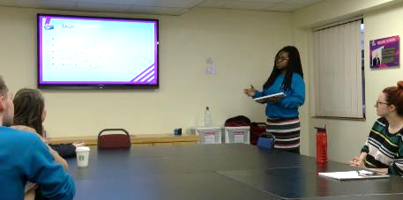
Student-led interventions – Consent Workshop Co-ordinator role
Created in 2016/17 academic year
Workshops delivered to 926 students
Student representative on Sexual Violence Working Group
Notes:
Our Consent Workshop Coordinator was a new role last academic year, and has shown great success, having delivered workshops to over 900 students in the first year. We will be opening applications for our next Consent Workshop Coordinator over the Easter holidays in order to train them in Term 3, ready to give workshops in September when students return for the Freshers period. Our Consent Workshop Coordinator, along with our Women’s Officer, both attend regular Sexual Violence Working Group meetings as student representatives along with myself, to ensure that the student voice is always heard by University staff. Having a new student in this role each year allows us to sustain our communication within this area with the student body, as well as developing new and innovative ways to reach out to new groups of students on campus.

Slide 40

Student-led interventions – Consent Week
Launched in 2016
Education on consent & opening up discussion
Timetable developed by students with guidance
Consent Week Timetable 2016
Notes:
Loughborough Students’ Union launched our first ever Consent Week two years ago in 2016. Since then, we have held a total of three Consent Weeks, with the most recent having been held in February. Consent Week aims not only to educate our students on issues surrounding consent, but also to open up discussion about consent and sexual violence, something that most students would suggest is difficult to talk about. Throughout the week this year, we put on a range of free events for students to get involved in, as well as launching our social media campaign, Let’s Talk About Consent, which featured photos of people in positions of power at the University and LSU showing their support.
The timetable this year, as in previous years, was developed by myself as the Welfare & Diversity EO alongside our Consent Workshop Coordinator, Tara, and our Women’s Officer, Kes, who are both students. Many of the ideas came from Tara and Kes, and I’m sure the week was a success because we knew what students would respond to well from our own experiences as Loughborough students. Our highlight event was our Bystander Intervention Theatre Performance, called ‘Step In: No Means No’, which was performed by 6 third year Drama students. This was an interactive piece of forum theatre, which examines the use of bystander intervention in everyday life, looking at a variety of different scernarios that our students often face, with an opportunity for the audience to intervene at any point. This event was definitely a success with around 70 students attending.

Slide 41
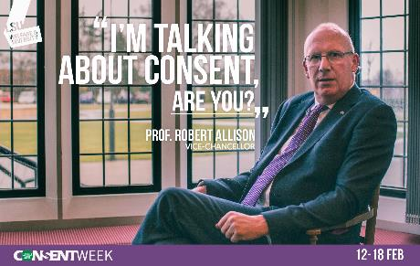

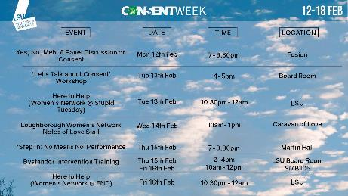
Notes:
(Talk about Ask for Angela)

Slide 42
Pulling the levers available
How do you engage those who need to be involved not just those who want to be?
Role modeling – training up Hall Committees/ Student Leaders
Incentivizing – Hall of the Year Points for consent training
Mandating – mandatory training for Fresher Helpers
Notes:
Now, with all of the approaches we’ve spoken, one of the key issues is getting those people other than the interested to get engaged. Again, we haven’t cracked this but the way we have tried to do it here is by using a range of different approaches:
Role modelling – BNOCs
Incentivizing – tap into Hall points here because of the importance of hall pride
Mandating in those areas where we need to – tell story of Fresher Helper training development.

Slide 43
Some thoughts on engaging students
Create the base first – underpinning work is important
Be collaborative from the outset
Be student-led in the interventions you create – engage students in creating and sharing the messaging
Pull the levers that you have available to you – understand what motivates your students
Be prepared to try things – and stop things that don’t work
Notes:
In terms of stopping things that don’t work, we’re reviewing the effectiveness of some of our training at the moment. If this isn’t being effective and having reach, we will stop using it and try something different.

Slide 44
Questions?
(and thanks for listening!)

Slide 45
Closing Remarks
Dr Manuel Alonso
Director of Student Services
Loughborough University

Slide 46
Survey
https://lboro.onlinesurveys.ac.uk/sexual-violence-in-higher-education-conference-survey

