Slide 1
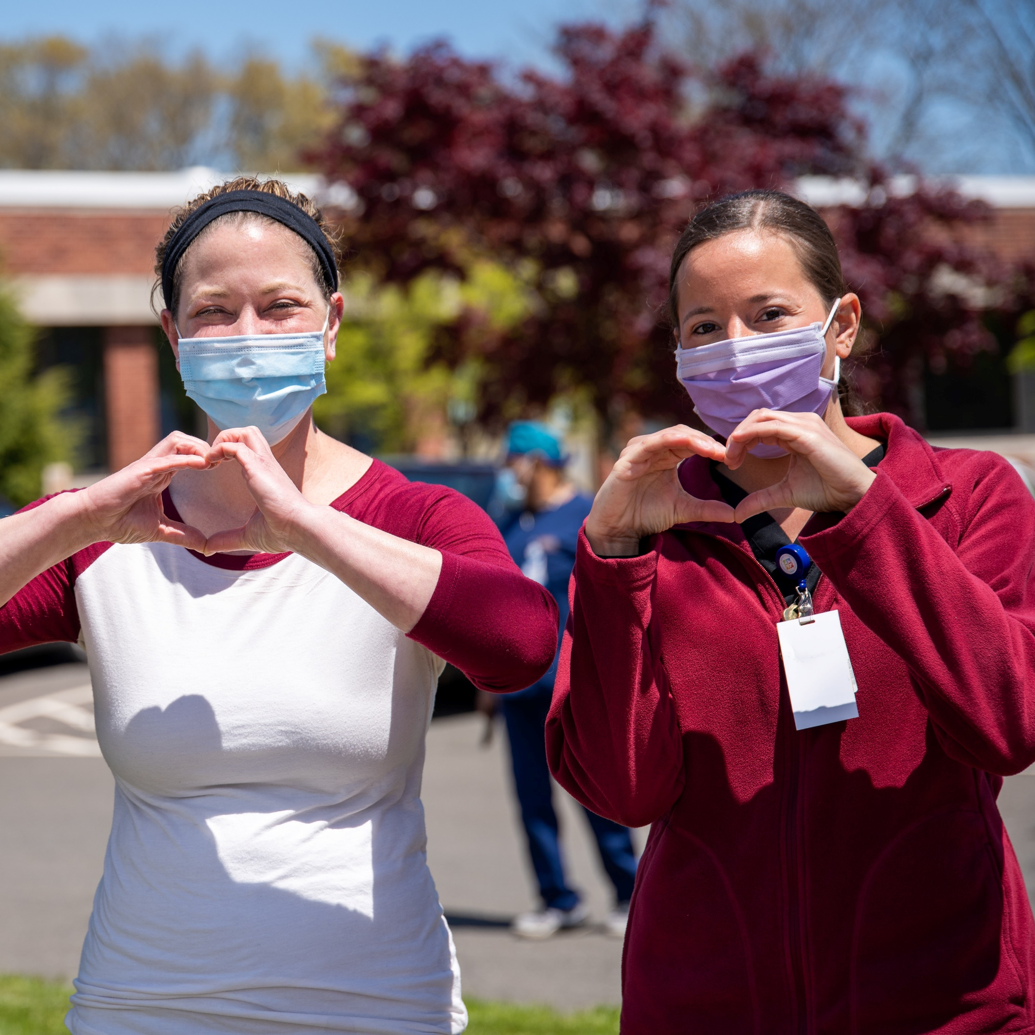
Strategic Interventions in Health Education Disciplines (SIHED)
Evaluation summary
Photo by Rusty Watson on Unsplash.com
April 2021

Slide 2
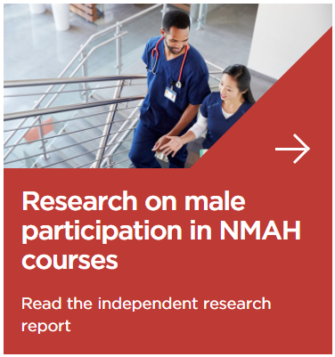
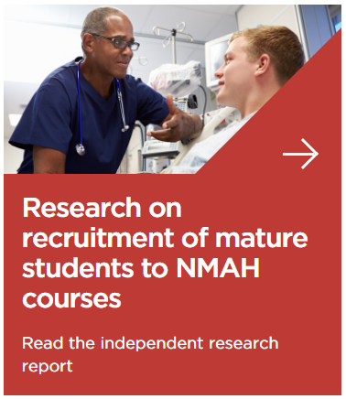
Strategic Interventions in Health Education Disciplines
Key facts
      Run by the Office for Students with management sub-contracted to the College of Podiatry
      Scope was allied health professions (AHPs) with a particular focus on four: Therapeutic Radiography, Orthoptics, Prosthetics and Orthotics, and Podiatry
      Ran for three years 2018/19 to 2020/2021
About this presentation
      Independent external evaluation from 2018
      Final full report published on Office for Students website
      Other resources also available on the website (see images)

Slide 3
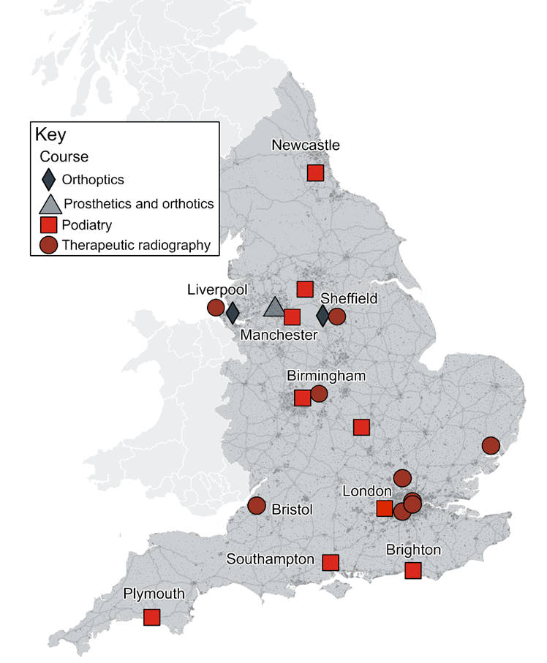
Why was SIHED needed?
Courses were vulnerable
      2016 saw peak number of applications across AHPs, but numbers fell after higher education funding reforms
      Number of mature students was also falling (down 23% between 2009 and 2018); this disproportionately affected some AHP courses
      The four subjects had few providers in England.
    Demand for AHPs was rising
      Ageing population: In 2018, 18% of population were aged >65 years; by 2050 this will be 25%
      Number of staff growing (197,000 registered AHPs in 2017 – 45% employed by NHS) but not fast enough to meet service demand.
Source: Produced by SQW 2018. License 100030994. Contains Ordnance Survey data © Crown copyright and database right 2018.

Slide 4
What was SIHED designed to do?
Raise awareness of the professions
Increase applications and acceptances to courses
Improve retention and student experience
Network practitioners and academics
    Key actions
Marketing campaign ‘ISeeTheDifference’
Secondments (work shadowing for orthoptists and work placements for podiatry and prosthetics and orthotics)
Challenge Funds: 16 funded projects led by universities to undertake innovative schemes relating to healthcare courses
Outreach officers (up to 6 full and part time posts)
Commissioned research into mature students and male participation

Slide 5




What did SIHED do to meet its four objectives?
Increase awareness of allied health disciplines
Created careers information and resources for young people and potential students
Resources co-created with members of the professions
Distributed via social media campaigns ‘ISeeTheDifference’
Encouraged interdisciplinary activity between AHPs through Challenge Fund initiatives
Increase understanding of and demand for the small and specialist disciplines
  Worked with professional bodies for the four disciplines
  Outreach activity with schools and colleges and at careers fairs and events
  Encouraged the professions to do outreach work with local schools and colleges
  Built work shadowing / experience capacity for potential students before they enrol
Strengthen and diversify delivery of the small and specialist disciplines
Developed initiatives to improve placement experience for students
Encouraged innovative use of simulation to support student learning
Provided opportunities to network and share experiences and learning
Increased understanding of the market for nursing, midwifery and allied health courses
  Commissioned research on mature student and male student motivations, experiences and decision making, to understand recruitment challenges
  Used marketing expertise to extend the reach of the campaign
  Encouraged use of student voice among Challenge Fund activities

Slide 6
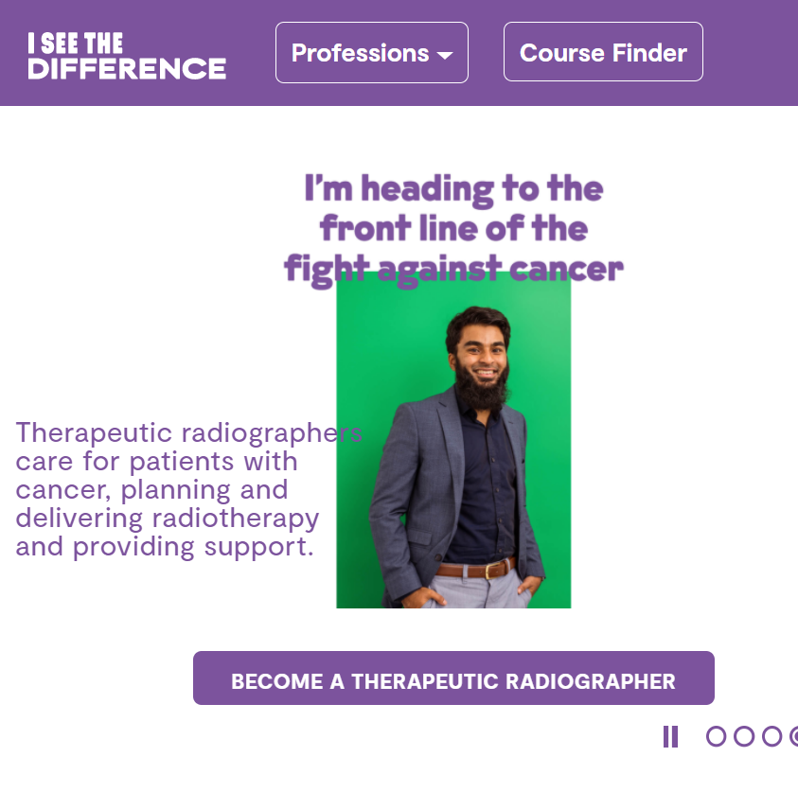
What did the programme deliver?
Key programme outputs included:
      345,000 unique individuals visited the ISeeTheDifference website
      Over 25,000 young people and 1,500 educational professionals engaged via either face to face or virtual workshops across 470 events
      1,400 serious conversations with potential applicants
      Delivery of 15 ‘Challenge Fund’ projects led by universities to support recruitment and retention objectives – the 16th could not progress due to Covid-19
      Well attended networking events held in London and Liverpool and, during 2020, these moved online
      A legacy plan for the final year to capture learning, share resources and continue the campaign.

Slide 7
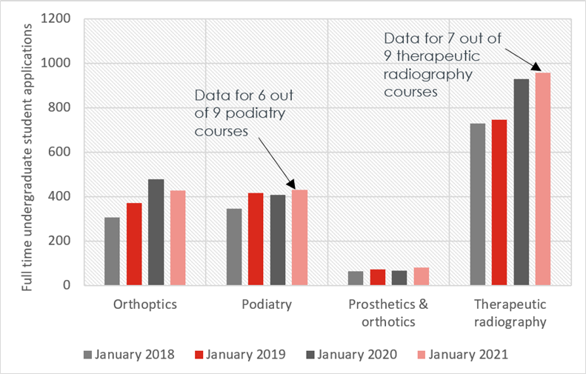
What has been the change in course applications?
Applications to all four professions have risen over the period
      Figure for 2021 had incomplete returns from 6 courses – but trend still positive
Provision has expanded
      New courses at foundation and postgraduate level
      New apprenticeship routes
Source: SQW course leader data feed
Note that the January 2021 returns do not include returns for three podiatry courses and two therapeutic radiography courses.

Slide 8
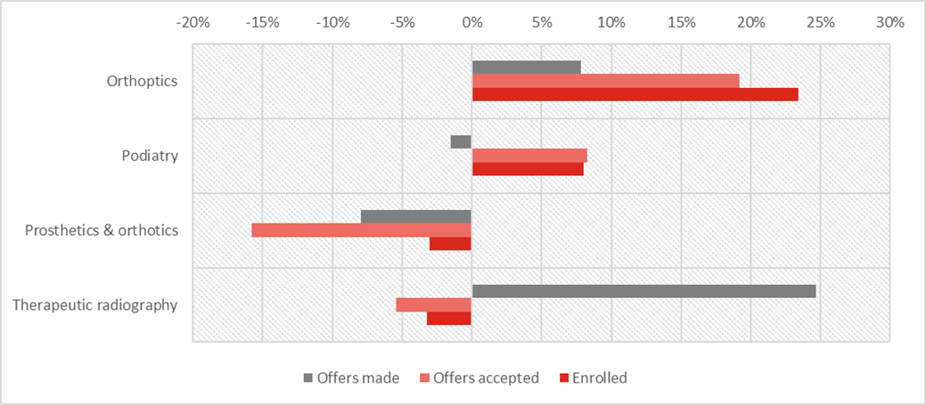
Changes to course enrolments
Positive trends
Chart: % change in offers, acceptances and enrolments Sept 2018 – Sept 2020
Across the subjects there has been positive change over the period (Note that the data is based on course leader survey returns – some incomplete)
The chart shows this varies by subject. It also varies by course: one therapeutic radiography provider saw a 96% increase in applications, another saw a 17% decrease in the same period.
 | 2018 | 2020 | % change
Offers made | 1076 | 1198 | 11%
Offers accepted | 585 | 599 | 2%
Enrolled | 544 | 568 | 4%
Source: Data provided by SIHED course leaders to SQW.
Not shown for Prosthetics and Orthotics as the one provider would be identifiable.

Slide 9
Key achievements of SIHED
2018 – 2021
Strategic partnerships
Working with the professional bodies
Mobilising members to help achieve objectives
Harnessing digital technology
Networking, collaboration and open communication
Sustainability built into planning

Slide 10


Key achievements
Strategic partnership
      Partners were:
        Professional bodies: The College of Podiatry; The Society and College of Radiographers; The British & Irish Orthoptic Society; and the British Association of Prosthetists & Orthotists
        Office for Students
        Council of Deans of Health
        Universities UK
        Health Education England
        Allied Health Professions Federation.
      Sustained, engaged members that met 3 times annually, providing direction and accountability. Responsive leadership to external changes.
Networking and collaboration
      Well managed programme
      Programme allocation was £3m; £1m each year over three years.
      Outreach officers and campaign team plus costs accounted for 70% of programme spend
      Strengthened networks and created new connections – contributing to more AHP-wide conversations
      Encouraged learning and reflection from different AHPs through commissioned research and Challenge Fund activities.

Slide 11


Key achievements
Working with the professional bodies
      Professional bodies would not have had the resources to drive this agenda alone
      Each has benefited from collective involvement while focussing on issues that are most pertinent to them
      For example: work shadowing for orthoptics and placement provision in public and private sectors for podiatry
      Legacy includes: resources and systems for work shadowing, stronger relationships with UK course providers, skills retained to continue to drive forward the agenda.
Mobilising members to help achieve objectives
      Volunteering by members to provide careers talks in schools and colleges in partnership with Inspiring the Future
      Member support to host or support work shadowing
      Involvement from members working in private practice to offer placements
      Member support for such initiatives is vital for student inspiration and support, and efforts should be recognised and celebrated.

Slide 12


Key achievements
Harnessing digital technology
      SIHED used digital tools to reach new audiences, reinforce 1-1 communications, and provide new digital experiences.
      Covid-19 accelerated digital innovation.
      Examples:
        ISeeTheDifference website and social media created a focus for key resources and stories
        Outreach moved to webinars and introduced new topics, alongside encouraging parental involvement
        Innovative alternatives to real-world work experience or work shadowing, using simulated experiences and VR headsets.
Sustainability built into planning
      Final two terms used by outreach team to deliver webinars and create a digital legacy including:
        Lesson plans for school and college teachers,
        ‘How to’ guides for individuals giving a careers talk
        Reflective learning from the marketing team
        ISeeTheDifference campaign to continue with support from Council of Deans of Health.

Slide 13
How much change is due to SIHED or other factors?
Other influences and drivers of change
SIHED programme
Bursary
Other campaigns
COVID-19
SIHED
Higher Education recruitment
NHS Learning Support Fund included £5,000 bursary for nursing, midwifery and many allied health students for 2020/21 undergraduate enrolments
NHS Careers campaigns and website “We Are the NHS”
HEE national and regional focus including AHP Day and WOW shows
In Feb 2021, UCAS reported an annual 32% increase in applications to nursing courses
Changed perceptions of healthcare professions
Continued marketing activities with open days and campaigns
Outreach work from all universities including AHP departments and admissions teams
Marketing and communications campaigns
Connecting the professions, course providers, and potential students
Revisions to work experience / shadowing
It is not possible to say which of these factors was the most significant – all have played a role.

Slide 14
SIHED was an ambitious programme, which has achieved progress towards all its objectives. Stakeholders praised the volume and variety of activity undertaken, as well as the enthusiasm and professionalism with which the programme was implemented.
It delivered diverse activities that combined to create a multitude of small changes to practice and behaviours.
Although student opportunities and experiences look different in 2021 compared with 2018, SIHED has not, unsurprisingly, delivered a step change. Nevertheless, it does leave a legacy of networks and learning.

Slide 15
What needs to be done now to raise awareness?
Continue the communication campaign | The ISeeTheDifference website and associated social media campaigns have a following that can be extended. Core resources should be promoted through these routes and new stories created for a dynamic and responsive campaign.
Plan ahead to align with national campaigns | Local activity can capitalise on interest created through national campaigns. The smaller professional bodies or course leaders can plan to align their activities to reinforce national campaign messages.
Connect the connectors | The professional bodies create a connection with AHP members; admissions teams at higher education provides connect with potential students; and careers organisations connect with all schools and colleges. Continued work to connect these groups should create synergies across the market.
Target outreach work | Outreach should be prioritised to target potential students from under-represented groups or places where skills shortages are expected.
Listen and learn | Continue evaluation and self-reflection activities to capture the ongoing effects the delivery of the programme, and to share learning emerging from the programme

Slide 16
What needs to be done now strengthen provision?
Prioritise placements | Limited placements constrain student numbers. Continue SIHED’s work by harmonising placement systems to make it easier for NHS and private employers to provide quality placements. Recognise and celebrate great supervision and create opportunities for placement supervisors to network and share learning.
Explore potential role of Integrated Care Systems (ICSs) | Course providers should consider the potential of alignment with ICSs in their local sub-regional area as a way to connect with the whole health and social care system.
Use simulation | Continue to embed simulation and use of new technologies in providing practical learning opportunities.
Seek economies of scale | Encourage closer collaboration within and between higher education providers, regulators and professional bodies to minimise duplication of effort in course delivery.
Explore new models of provision | SIHED stakeholders should continue to discuss apprenticeship pilots with NHS employers and private sector providers. This is with a view to maximising opportunities created by the application of the apprenticeship levy alongside bursaries.

Slide 17
Web links referenced in these slides
www.officeforstudents.org.uk/publications/male-participation-in-nursing-and-allied-health-higher-education-courses/
www.officeforstudents.org.uk/publications/research-on-recruitment-of-mature-students-to-nursing-midwifery-and-allied-health-courses/
www.millionplus.ac.uk/policy/reports/forgotten-learners-building-a-system-that-works-for-mature-students
www.iseethedifference.co.uk/
www.nhsbsa.nhs.uk/nhs-learning-support-fund
www.ucas.com/corporate/news-and-key-documents/news/nursing-applications-soar-ucas-publishes-latest-undergraduate-applicant-analysis
www.nhs.uk/wearethenhs
www.england.nhs.uk/ahp/ahps-day/
www.thewowshow.org/thinking-of-becoming-an-ahp-student/
www.iseethedifference.co.uk/

Slide 18
Contact
  For more information:
    Lauren Roberts
      Director
    SQW
        t. 0161 475 2117
        e. lroberts@sqw.co.uk
    Dr Jo Hutchinson
      Associate Director
    SQW
        t. 0161 475 2116
        e. Jhutchinson@sqw.co.uk

